Slide 1
An insight into the Video Codec
-Guruchethan D P

Slide 2
Image representations
RGB
  Uses 3 primary colors – Red, Green, Blue
  These 3 are added in different ways to get wide array of colors
YUV
  The YUV color space is encoded digitally as YCbCr. Y – luma component Cb,Cr- chroma component
  Chroma components are sub sampled taking advantage of the fact that human visual system is less sensitive to color differences than for luminance

Slide 3
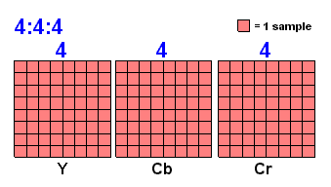
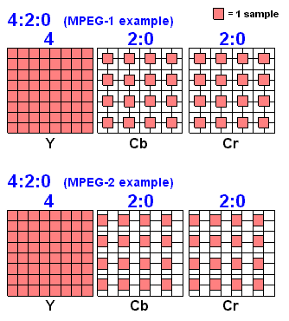
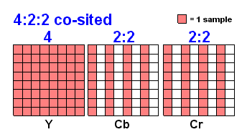
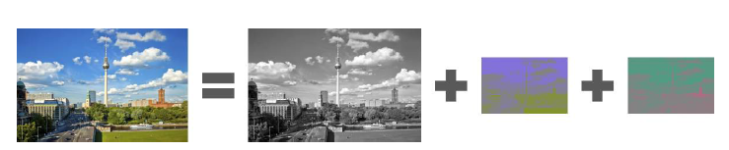
Chroma sub sampling

Slide 4
JPEG Image coding
[Ref: Image compression and the Discrete Cosine Transform, Ken Cabeen and Peter Gent]
The image is broken into 8x8 blocks of pixels
DCT is applied to this 8x8 block
Each block is compressed through quantization
Blocks are coded in a zigzag path and array of blocks are stored in drastically reduced space
When desired, image is reconstructed by applying inverse quantization and IDCT

Slide 5
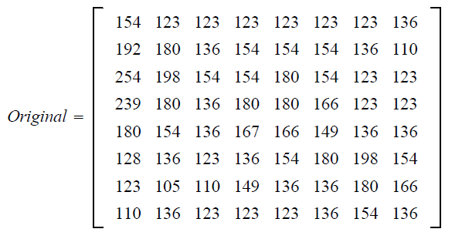
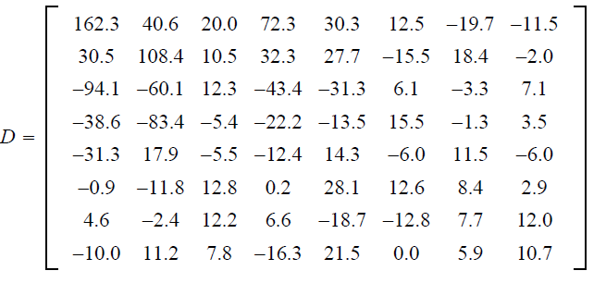

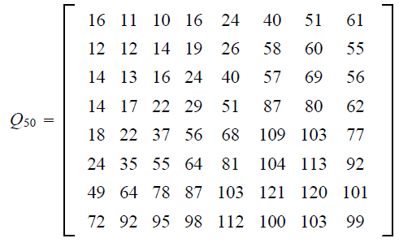
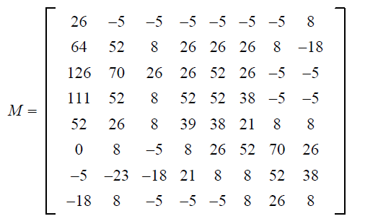
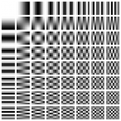
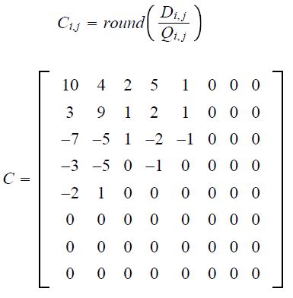
Example demonstrating the JPEG process [Ref: Image compression and the Discrete Cosine Transform, Ken Cabeen and Peter Gent]

Slide 6
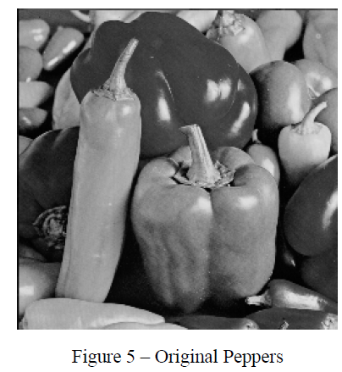
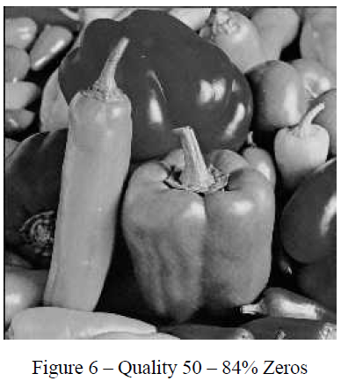
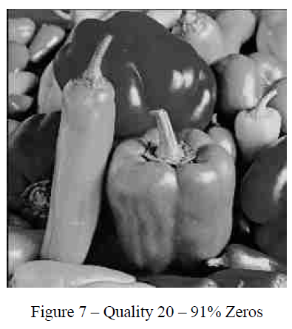
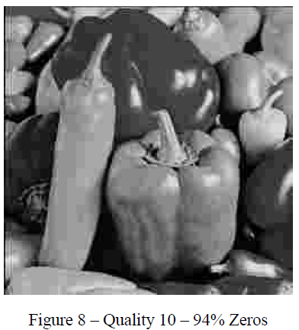
Comparison between different quality level matrices
[Ref: Image compression and the Discrete Cosine Transform, Ken Cabeen and Peter Gent]

Slide 7
Video compression
What part of the video signal should be coded using what method?
Intra mode
  Entire block is coded using image compression methods like JPEG
  Used for blocks which cannot be predicted well
Inter mode
  Large amount of temporal redundancy in the video content.
  Predict a new frame from the previous frame
  For each 16x16 ( macro block), find the best match from previous frame
  Prediction error will be coded using DCT
  One pair of motion vectors are also coded.

Slide 8
Inter + 4V mode
  Same as Inter mode except 4 motion vectors are used
Bidirectional mode
  Same as Inter mode but macro block is predicted from previous and following frame
  Hence 2 pairs of the motion vector are required
Skip mode
  Some areas of the frame can just be repeated without any change

Slide 9
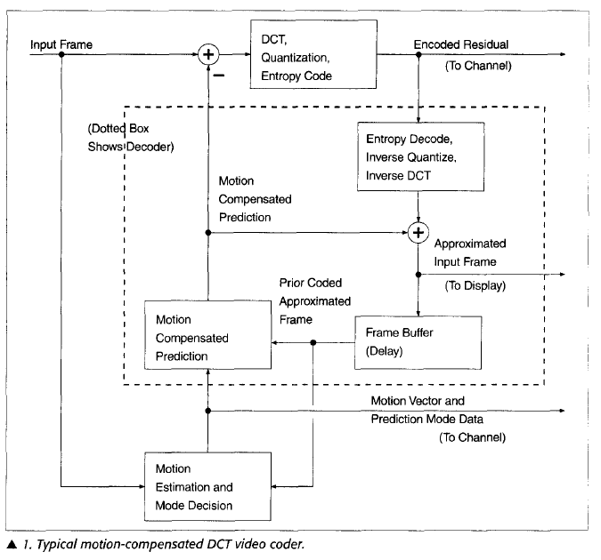
DCT video coder [Ref: Rate-distortion optimization for video compression, Gary J Sullivan and Thomas Wiegand]

Slide 10
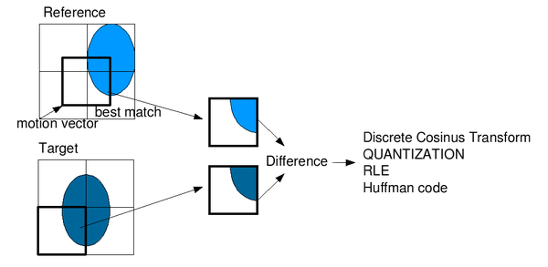
Motion compensation

Slide 11
Some terminologies..
Bit rate
  Number of bits that are conveyed or processed per unit of time
  Units: bits/sec
  Higher the bit rate, higher the quality of the image
Y-PSNR
  Y- PSNR(Peak SNR) is the ratio between the maximum possible value (power) of a signal and the power of distorting noise that affects the quality of its representation.
  Here signal refers to Y-luma component

Slide 12
Some terminologies.. (contd)
Quantization parameter( QP )
  It represents the amount by which you quantize a DCT coefficient
  QP will be higher for high frequency coefficients in order to reject them

Slide 13
H.264/AVC
Latest standard in a sequence of video coding standards H.261(1990), MPEG1 (1993), MPEG-2(1994), H.263(1995, 1997), MPEG-4 visual(1998)
Developed by joint collaboration of ITU-T and MPEG in May 2003

Slide 14
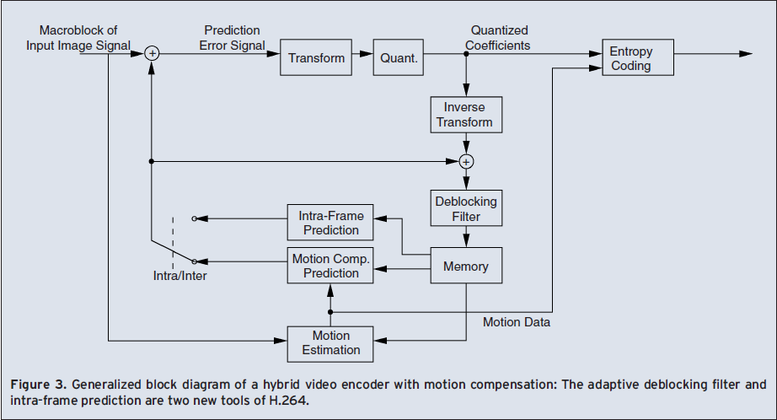
H.264/AVC block diagram
[Video coding with H.264/AVC by Ostermann, Bormans, List, Marpe, Narroschke, Pereira, Stockhammer, Wedi]

Slide 15
H.264/ AVC features
2 conceptual layer structure
  Video Coding Layer ( VCL): defines efficient representation of the signal
  Network Adaption Layer ( NAL ): Converts VCL representation into a format suitable for a specific transport layer
Intra frame prediction-
  Prediction within a single frame

Slide 16
H.264/ AVC features ( contd..)
Memory
  For motion compensation, multiple video frames are used instead of one.
  Due to intra frame prediction
Deblocking filter
  Used to improve visual quality and prediction performance by smoothing the sharp edges which can form between macroblocks when block coding techniques are used.
Integer transform
  Simple approximation to DCT

Slide 17
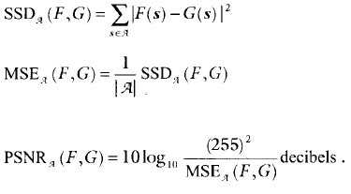

Rate Distortion Optimization
Minimize the distortion, subject to a constraint on the number of bits used
Parameters to measure distortion
  Sum of Squared Differences ( SSD )
  Mean Squared Error ( MSE )
  PSNR (Peak Signal to Noise Ratio )
  Sum of Absolute Differences ( SAD )

Slide 18
Lagrangian Formulation
Min{ J }, where J = D +λR
  Where J- Lagrangian rate- distortion function
  D- Distortion measure (PSNR, SSD, SAD or MSE)
  λ- Lagrange multiplier
  R- Rate
  We need to minimize J for a given value of λ and Rc.
  λ specifies the relative emphasis between the R and distortion

Slide 19
Bit rate depends on..
Prediction-mode choices
Motion vector choices
Coding techniques of the prediction error
Quantization step size

Slide 20
Prediction mode selection based on Lagrange optimization
Minimize the following function
  J(M) = D(M) + λ_{MODE} R(M)
  Tune the λ_{MODE} to get the relative dependency between D and R, then choose the mode that minimizes J
  It is found that λ_{MODE} is directly related to
  quantization step size by
  λ_{MODE} = c Q²

Slide 21
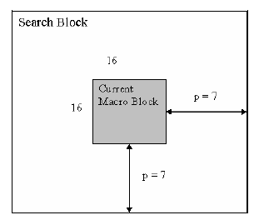
Motion vector estimation based on Lagrange optimization
Ref: Block matching Algorithms for motion estimation, Aroh Barjaty
Motion vector estimation done using block matching
Divide the current frame into macro blocks that are compared with corresponding block and its neighbors in the reference frame
Search area is limited to p pixels around as shown.
Usually p=7 and macro block size =16 x 16
Commonly used cost functions for the motion estimation are MAD(Mean Absolute Difference) and MSE(Mean Squared Error )
Motion vectors can be optimized using formulating the problem as Lagrange function.

Slide 22
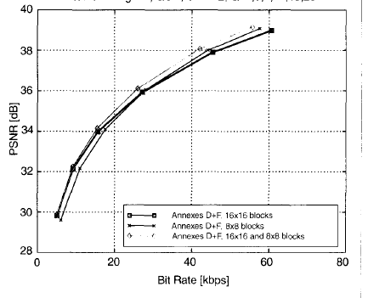
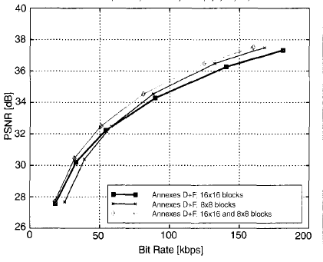
Motion compensation using variable block sizes
[Ref:Rate-distortion optimization for video compression, Gary J Sullivan and Thomas Wiegand
Mother-Daughter, QCIF Foreman, QCIF

Slide 23
References
Image compression and the Discrete Cosine Transform, Ken Cabeen and Peter Gent
Source Coding and compression by Heiko Schwarz
Video coding with H.264/AVC by Ostermann, Bormans, List, Marpe, Narroschke, Pereira, Stockhammer, Wedi
Rate-distortion optimization for video compression, Gary J Sullivan and Thomas Wiegand
Block matching Algorithms for motion estimation by Aroh Barjaty

Slide 24
THANK YOU
Q & A

